Slide 1

FITNESS TRACKER SYSTEM
NAME: PALLA BHARATH KUMAR
Intern Id: MST03-0089
Domain: data science training
META SCIFOR TECHNOLOGIES
UNDER THE GUIDANCE OF
UROOJ KHAN

Slide 2
AGENDA
Introduction
Project Overview
Key Features
Methodology
Implementation
Results
Conclusion

Slide 3
INTRODUCTION
The Fitness Tracker System is a data-driven approach to monitoring and analysing fitness metrics, designed to assist users in achieving their health goals. By leveraging advanced data science techniques, the system processes key metrics such as calories burned, BMI, and workout frequency to provide actionable insights. Using a robust dataset of over 1,000 records, it employs machine learning models to predict outcomes and recommend personalized fitness routines. The system integrates exploratory data analysis, feature engineering, and visualization tools to uncover trends and correlations, making it a comprehensive solution for enhancing personal health and fitness.

Slide 4
Project Overview
The Fitness Tracker System is a comprehensive application that utilizes data science to transform raw fitness data into meaningful insights. It analyses user-specific metrics such as age, weight, workout frequency, session duration, and calories burned to provide personalized recommendations for optimizing fitness routines. By combining techniques like data pre-processing, feature engineering, and machine learning, the system achieves high prediction accuracy and ensures actionable outputs. The project highlights the integration of technology in promoting healthier lifestyles and serves as a scalable framework for personal fitness tracking and analysis.

Slide 5
Key Features
BMI Calculation: Automatically calculates and categorizes Body Mass Index
(BMI).Workout Insights: Analyses session duration, frequency, and caloric expenditure.
Machine Learning Models: Utilizes Logistic Regression, Decision Trees, and Random Forest for predictions.
Data Visualization: Generates heat-maps, scatter plots, and histograms for fitness trends.
One-Hot Encoding: Processes categorical data like gender and workout type.
Scalable Framework: Handles datasets with over 1,000 records for robust analysis.
Model Deployment: Supports saving and loading models for reuse using pickle.

Slide 6
METHODOLOGY
Data Understanding: Examine the dataset, its attributes, and structure.
Data Cleaning: Handle missing values, remove duplicates, and ensure consistent data types.
Feature Engineering: Derive new metrics like BMI and categorize variables (e.g., age groups, BMI categories).
Data Transformation: Apply scaling and one-hot encoding for pre-processing.
Dataset Splitting: Split data into training and testing sets (80-20 ratio).
Model Training: Train machine learning models like Logistic Regression, Decision Trees, and Random Forest.
Model Evaluation: Assess models using accuracy, precision, recall, and F1-score metrics.
Insights & Recommendations: Provide actionable results and fitness optimizations.

Slide 7
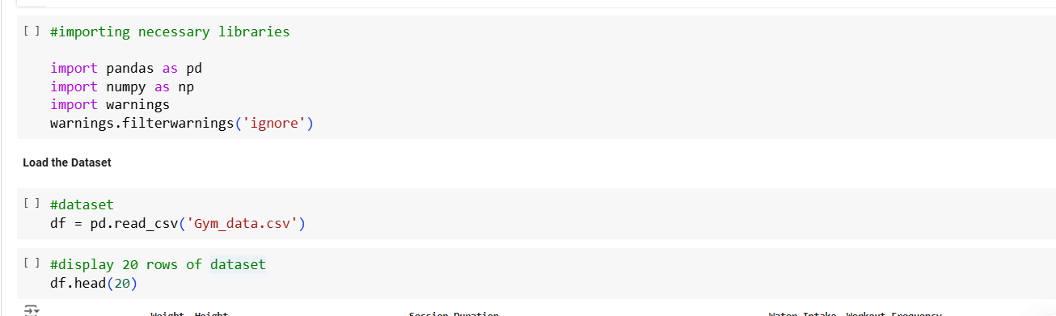
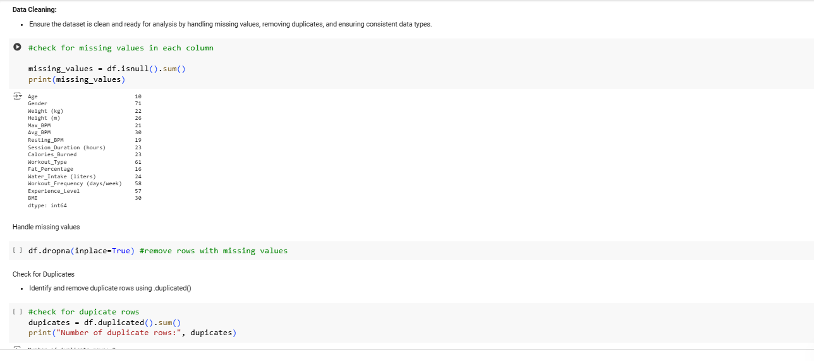
Implementation

Slide 8
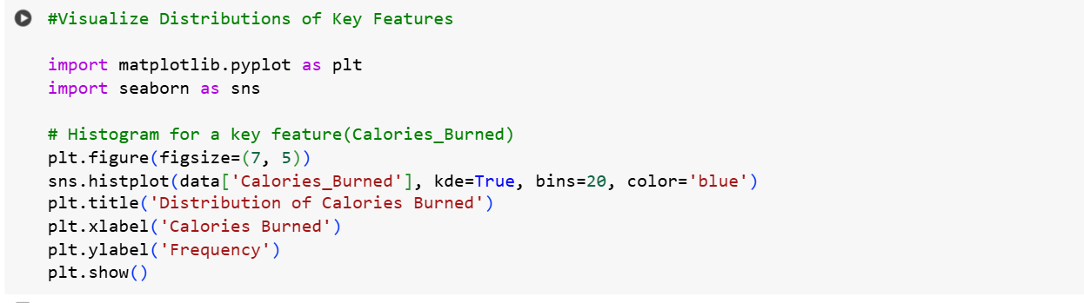
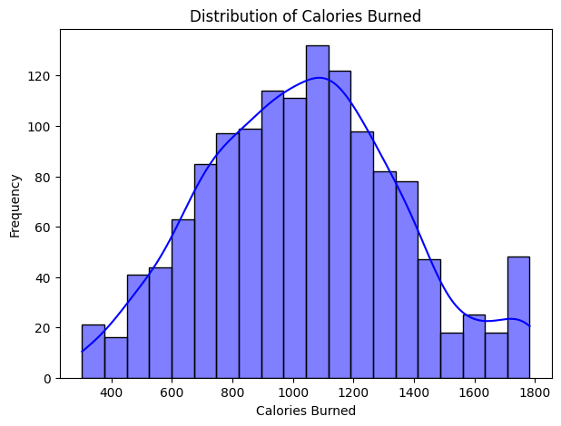
Exploratory Data Analysis (EDA):
Gain insights from the dataset through summary statistics, visualizations, and relationship analysis.
# Summary statistics for numerical features
print(df.describe())

Slide 9
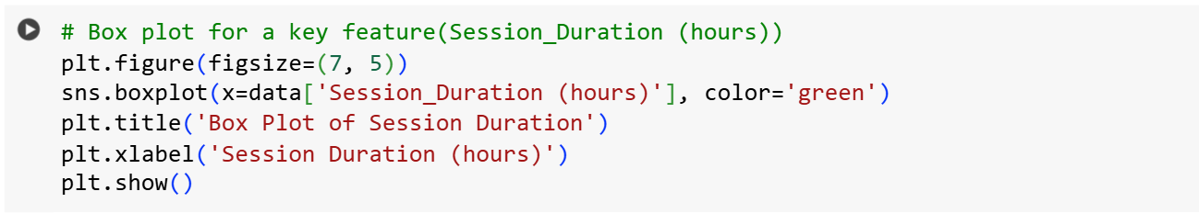
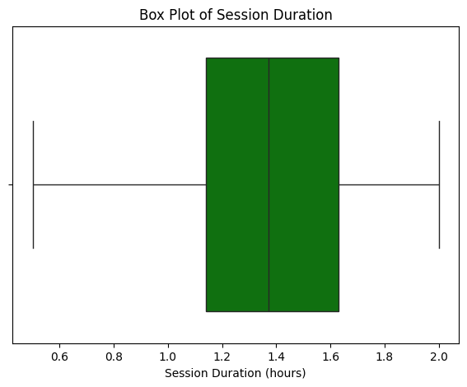

Slide 10
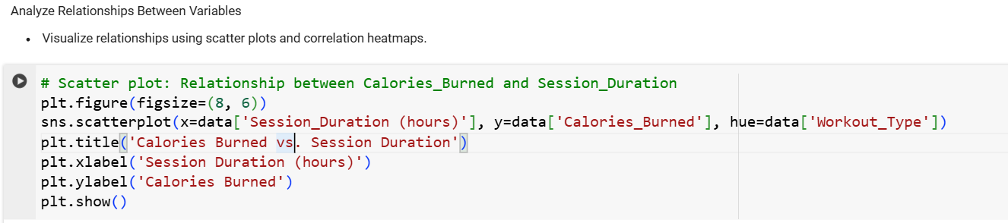
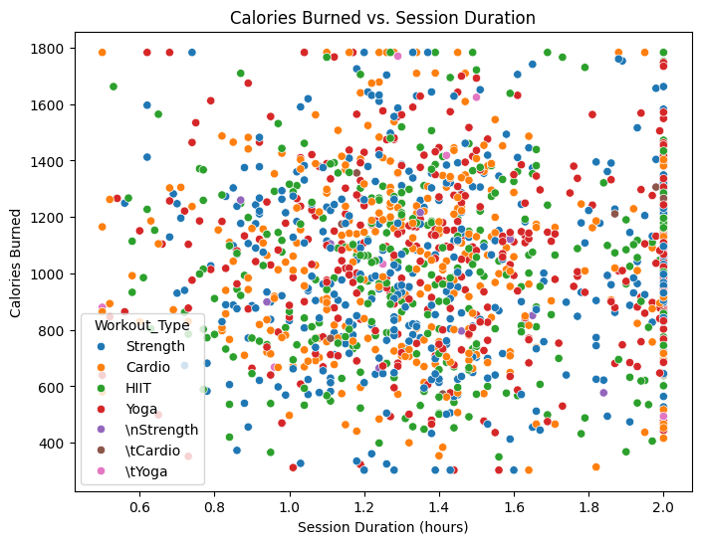

Slide 11
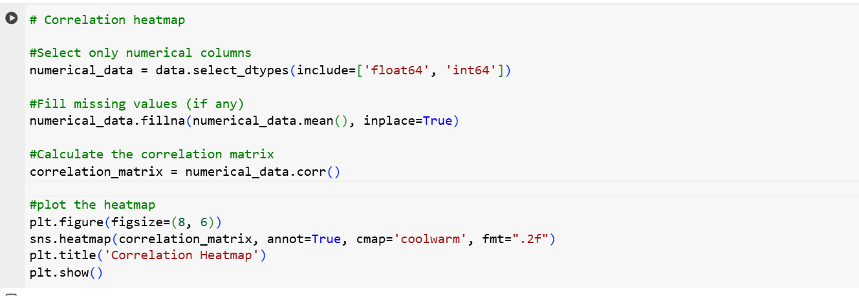
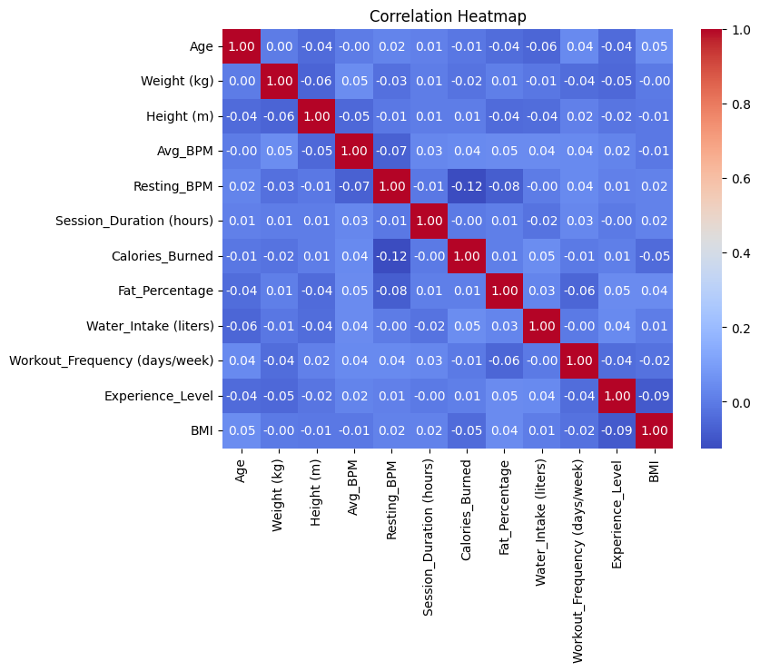

Slide 12
Dataset Splitting
Split the dataset into training and testing subsets to evaluate machine learning models effectively.
Identify Features and Target
Separate the independent variables (features) from the dependent variable (target)
# Define features (X) and target (y)
X = scaled_data.drop(columns=['Calories_Burned'])
y = scaled_data['Calories_Burned']
Split the Dataset *Use train_test_split from sklearn to divide the dataset
from sklearn.model_selection import train_test_split
# Split the data into training and testing sets
X_train, X_test, y_train, y_test = train_test_split(X, y, test_size=0.2, random_state=42)
Model Training
Train the selected models on the training dataset and optimize performance through hyper-parameter tuning
#check for categorical columns
#identify columns in X_train are non-numeric
#check for non-numeric columns
non_numeric_cols = X_train.select_dtypes(include=['object']).columns
print("Non-numeric columns in X_train:\n", non_numeric_cols)

Slide 13
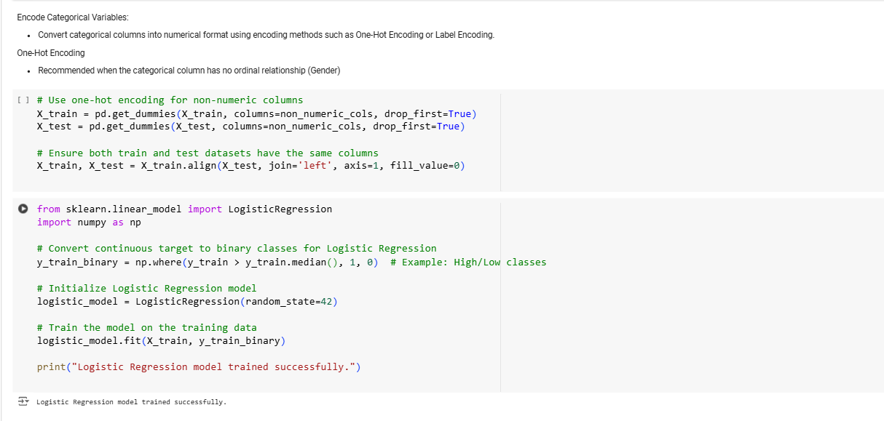

Slide 14
# Summarize model evaluation metrics
print(f"Metrics:")
print(f"Accuracy: {accuracy:.2f}")
print(f"Precision: {precision:.2f}")
print(f"Recall: {recall:.2f}")
print(f"F1 Score: {f1:.2f}")
Save Model Using pickle
Pickle is a Python library for serializing and deserializing objects.
import pickle # Save the model
with open('decision_tree_model.pkl', 'wb') as file:
pickle.dump(classifier, file)
print("Model saved as decision_tree_model.pkl")

Slide 15
Results
Model Performance:
Random Forest Classifier achieved an accuracy of 98%, demonstrating robust prediction capability for caloric expenditure and other fitness metrics.
Feature Insights:
BMI, workout frequency, and session duration emerged as the strongest predictors of calories burned.
Visual Trends:
Scatter Plots: Highlighted a positive correlation between session duration and calories burned.
Heatmaps: Revealed significant relationships among numerical features like BMI and caloric expenditure.
Evaluation Metrics:
Precision, recall, and F1-scores were consistently high, confirming the reliability of the model.

Slide 16
Conclusion
The Fitness Tracker System successfully leverages data science to provide accurate and actionable insights into user fitness metrics. By integrating robust data pre-processing techniques, feature engineering, and machine learning models, the system achieves high prediction accuracy (98%) for caloric expenditure and related fitness variables. Key insights, such as the impact of BMI and workout frequency on fitness outcomes, demonstrate the system's ability to guide personalized routines. This project highlights the potential of technology in promoting healthier lifestyles and sets a strong foundation for future enhancements, such as real-time data integration and advanced predictive modelling.

Slide 17
THANK YOU!

